Slide 1
Docker and Kubernetes
deployment
Group 4
Yashwanth Reddy
Suraj Yadav
Pawanesh Singh
Om Patre
Naman Lad

Slide 2
Online Job Profile
Candidates, graduates, freshers or experienced have to travel a lot and search for jobs that suits them.
The process of recruitment can be complex and scale as per organization’s size.
Organizations across different verticals have to look for suitable candidate, place advertisement for interviews, do screening for candidates conduct interviews, and select suitable person for the job.
For this an online application is required that can fulfil requirements of both candidate and employee.

Slide 3
Using Docker
We created a docker image for our java spring boot application
The application image need postgres database

Slide 4
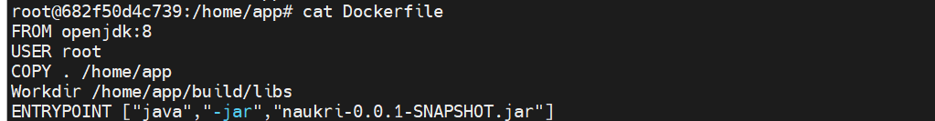
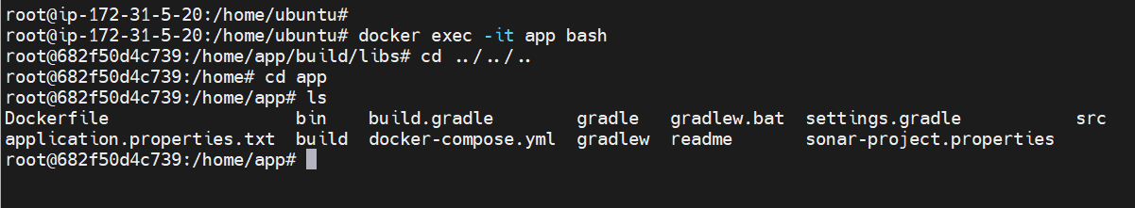
Using Docker - Image Creation

Slide 5
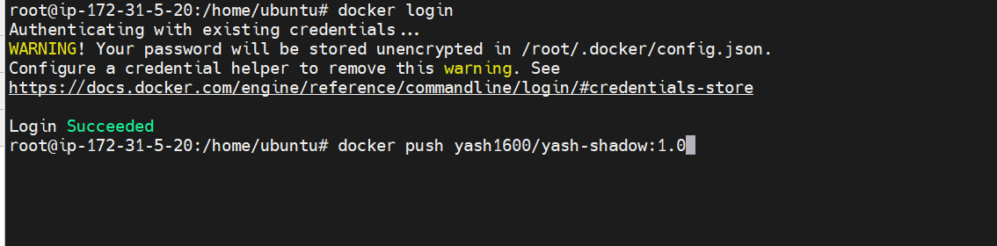
Using Docker - Registry
Pushing the image by logging in

Slide 6
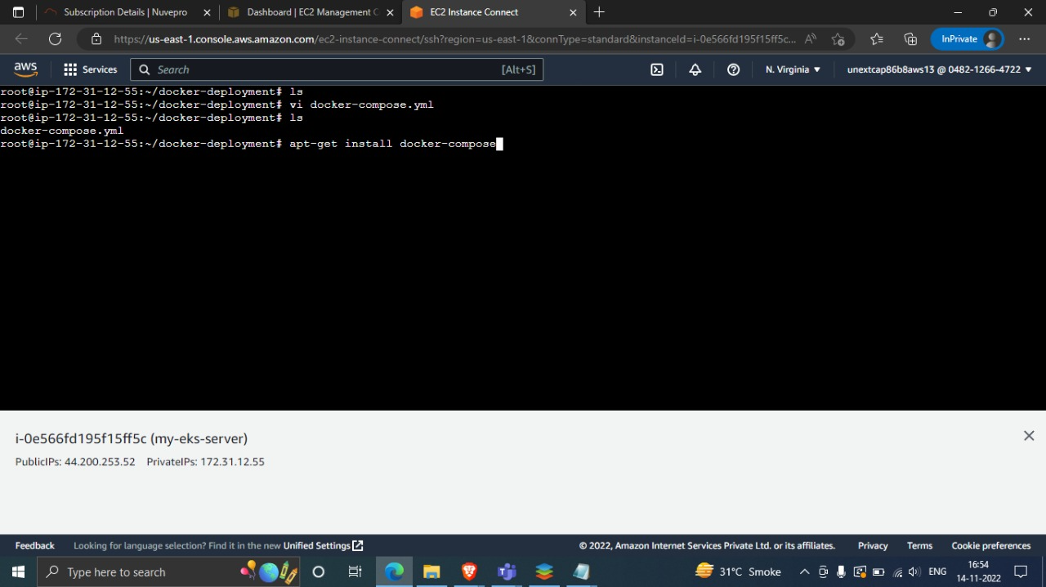
Using Docker

Slide 7
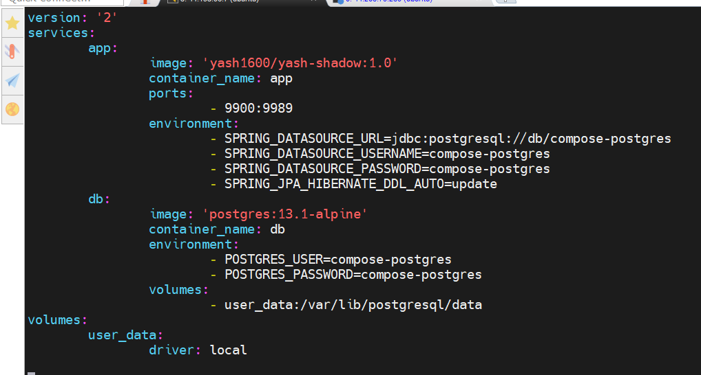
Using Docker
docker-compose.yml

Slide 8
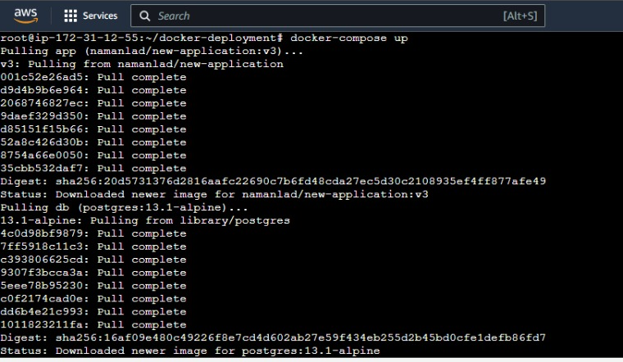
Using Docker

Slide 9
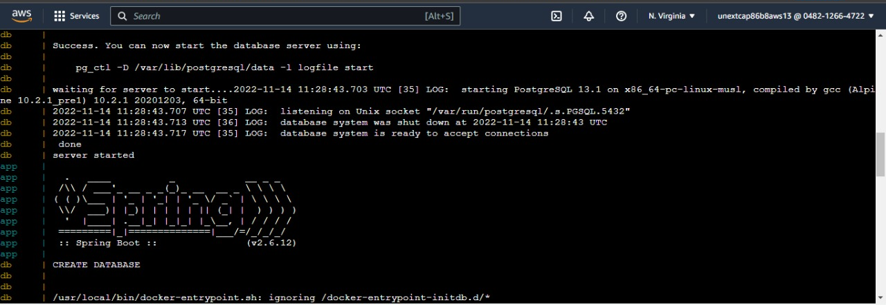
Using Docker

Slide 10
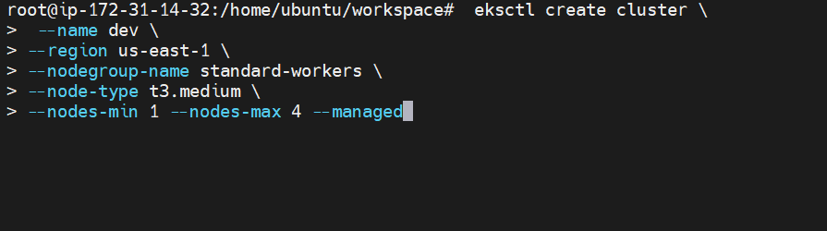
Using Kubernetes/EKS

Slide 11
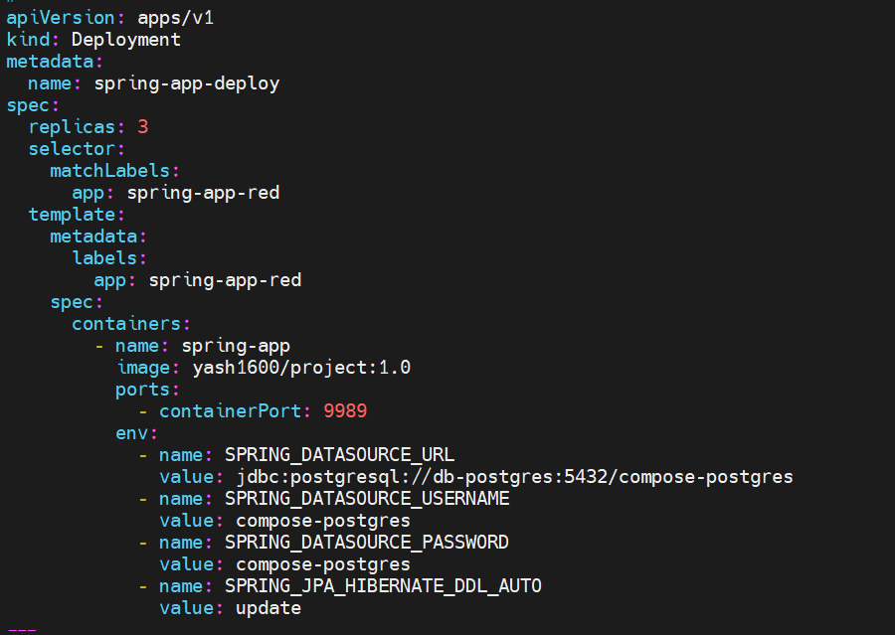
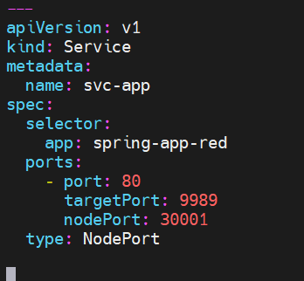
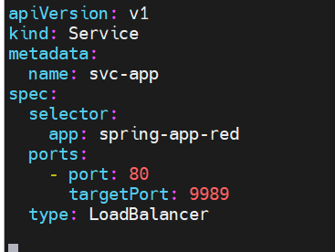
Using Kubernetes/EKS
deploy_app.yml

Slide 12
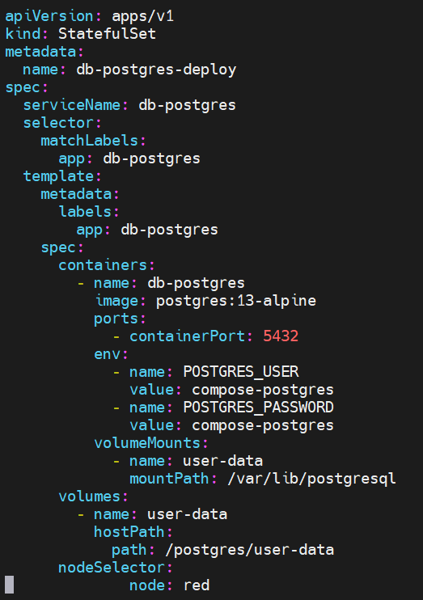
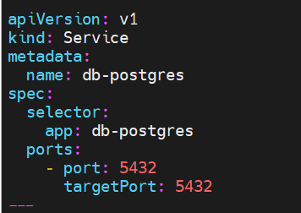
Using Kubernetes/EKS
deploy_db.yml

Slide 13
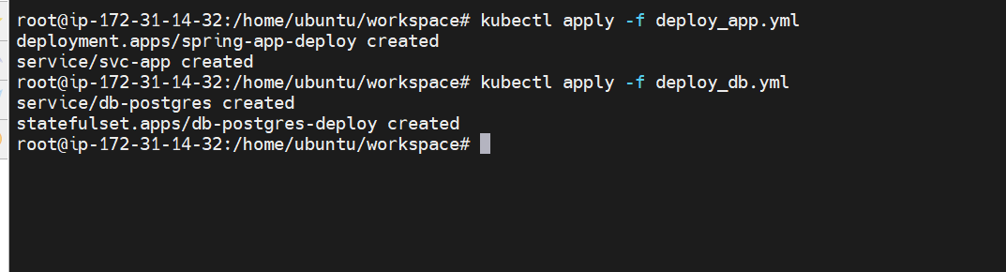
Using Kubernetes/EKS

Slide 14
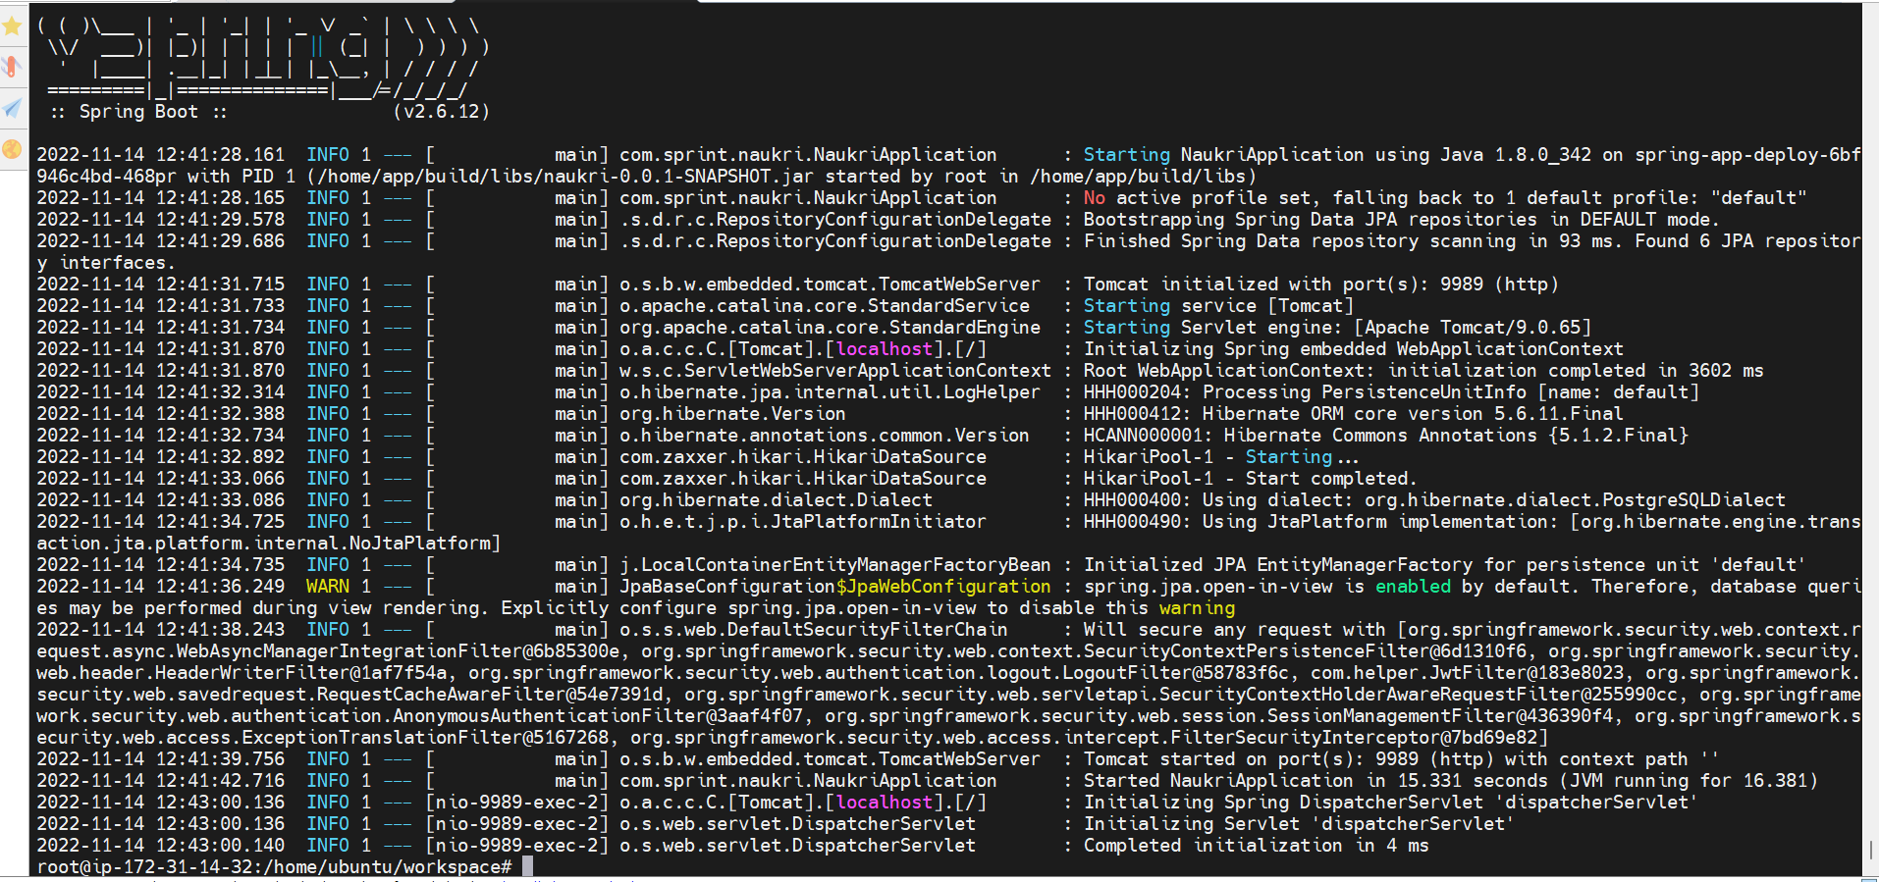
Using Kubernetes/EKS

Slide 15
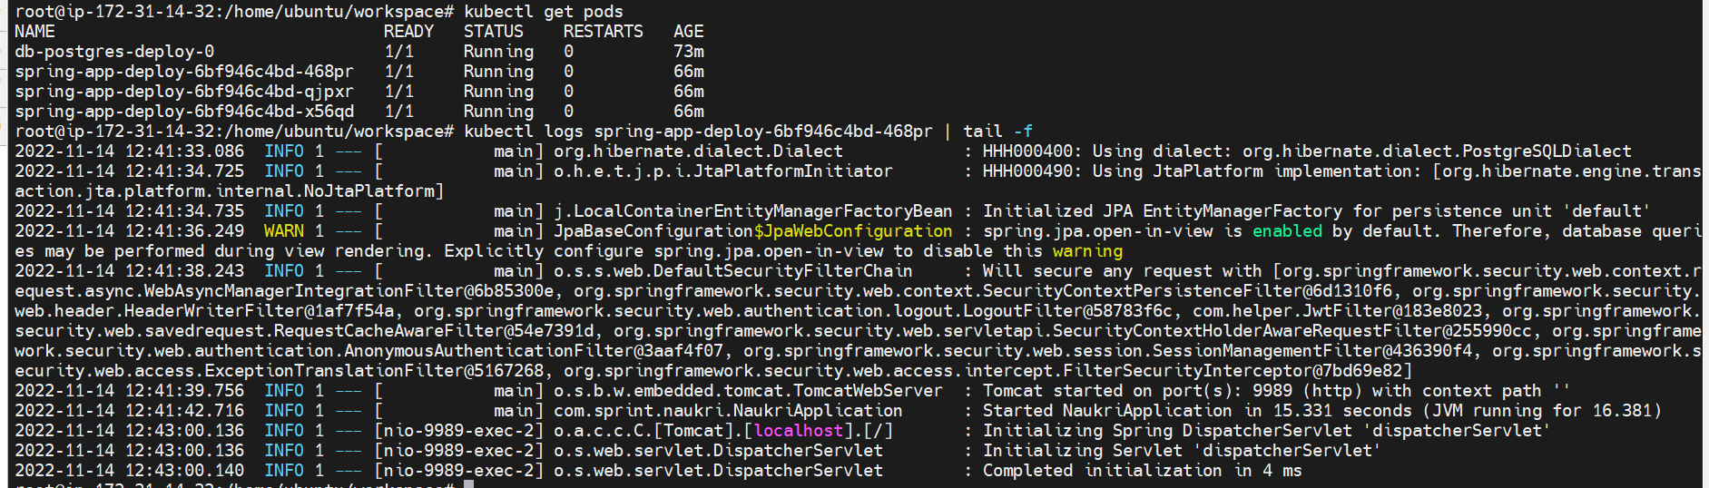
Using Kubernetes/EKS

Slide 16
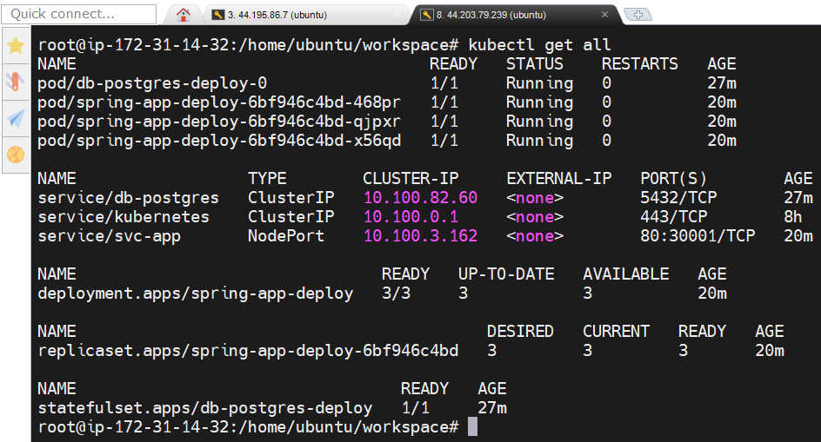
Using Kubernetes/EKS

Slide 17
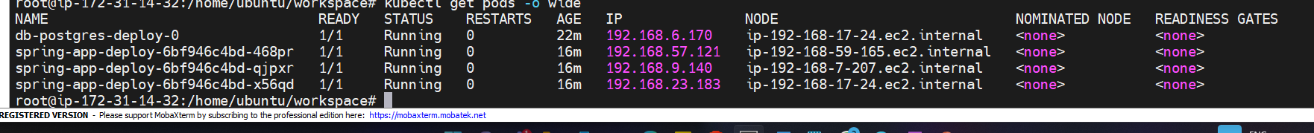
Using Kubernetes/EKS

Slide 18
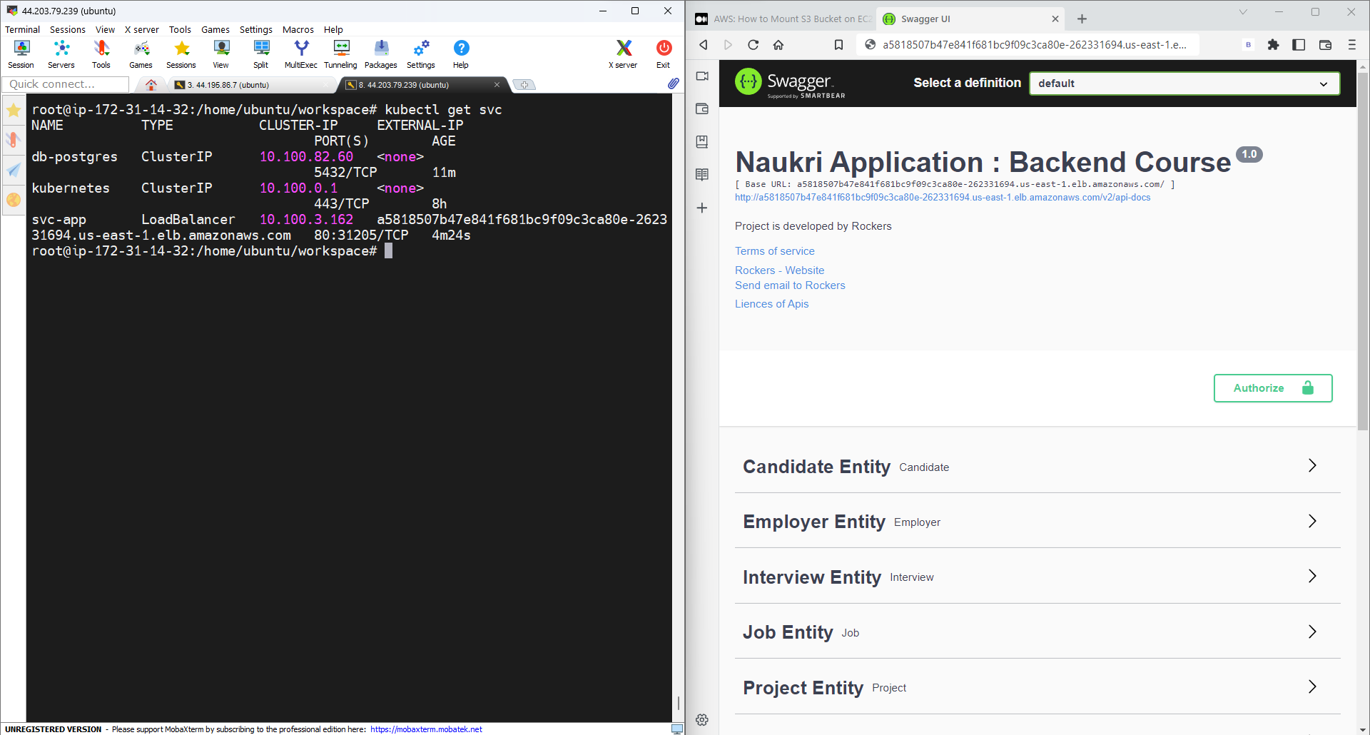
Using Kubernetes/EKS

